Slide 1
Application of AI in CyberSecurity
Kanishk Thamman
6/18/2024

Slide 2
Kanishk Thamman
Junior at Wakeland High, TX
CCST Cybersecurity
IT Specialist - Cybersecurity
I love AI and Cyber Security
In my free time, I help with audio and lights for shows

Slide 3


What is Autonomous CyberDefense ?
Autonomous Cyber Defense describes systems capable of protecting organizations and users through system hardening, network and endpoint management, threat detection, and intrusion response and recovery, without direct human tasking.
(Lohn et al.)
Source: https://blogs.uwe.ac.uk/cyber-security-cyber-crime/measuring-the-suitability-of-artificial-intelligence-in-autonomous-resilience-for-cyber-defence/

Slide 4
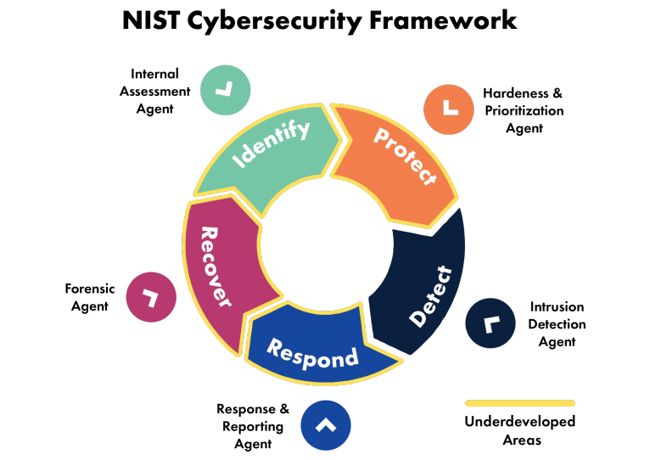
Why Autonomous CyberDefense ?
Example Use Cases:
Using AI to detect and take action against a cyber attack
Autonomous software pen-testing to look for vulnerabilities
Predictive approach to CyberSecurity
(Lohn et al.)

Slide 5

Why do I like Autonomous CyberDefense ?
It can be cost effective since it is one tool for small companies
It allows for better and faster control and incident response which will help prevent or mitigate the extent of an attack
Its development and inception is inevitable, might as well help the Whitehat hackers implement it first
Its an Emerging Technology which means that I can contribute and make a huge impact
(H. Jahankhani et al.)

Slide 6
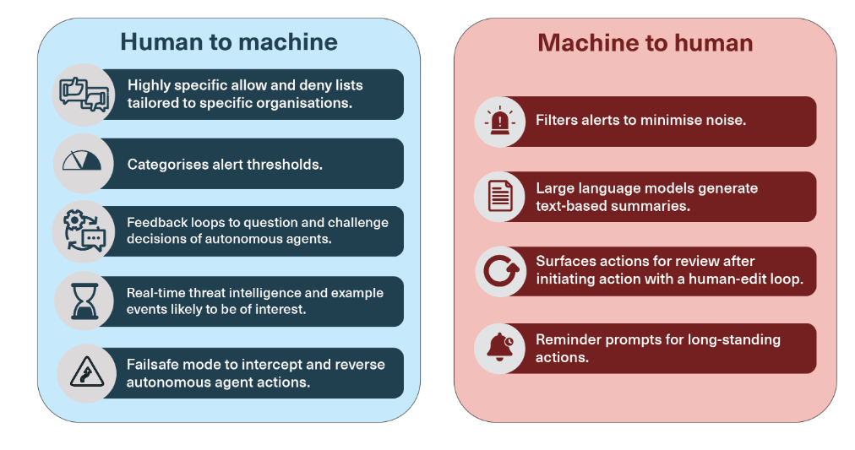
How would Autonomous CyberDefense work?
(Knack and Burke)

Slide 7
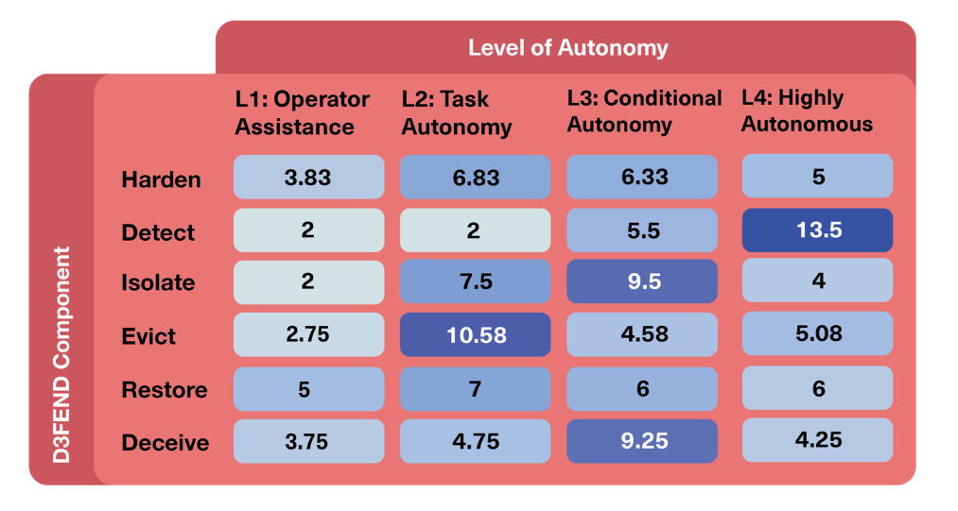
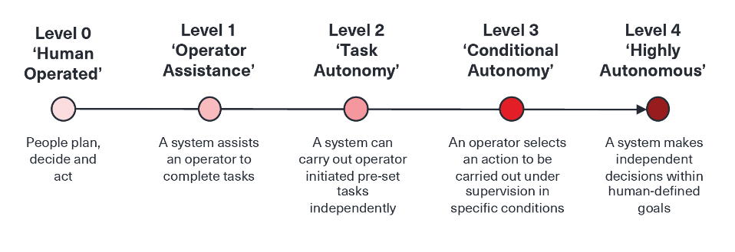
Future Implications of Autonomous CyberDefense
(Knack and Burke)
Notes:
Participants often expressed comfort for a highly autonomous system to be readily applied to tasks or activities that were seen as “low regret” – situations and actions that cause minimal impact on an organisation. Identifying “low regret” use cases was challenging however, because there are risks across almost all MITRE D3FEND actions. Many participants also expressed concern about the prospect of introducing new, poorly understood technical vulnerabilities into an organisation through adoption of autonomous agents and unknown risks.
The score is calculated from data of participant responses to acceptable autonomy levels for the D3FEND components. Participants were free to choose 1, many, all or no levels of autonomy for each D3FEND component. Where a participant selected a single autonomy level (e.g. Level 2 for ISOLATE) a score of 1.0 is recorded. Where a participant selected more than one autonomy level, this 1.0 score is divided evenly amongst the selected levels (i.e. 0.5 each for 2 selections, 0.33 each for 3 selections and 0.25 each if all four autonomy levels were selected).

Slide 8


Thank You
Kanishk Thamman
Kanishk-Thamman
kthamman@purdue.edu

Slide 9
Work Cited
Jahankhani, H., Meda, L.N.K., Samadi, M. (2022). Cybersecurity Challenges in Small and Medium Enterprise (SMEs). In: Jahankhani, H., V. Kilpin, D., Kendzierskyj, S. (eds) Blockchain and Other Emerging Technologies for Digital Business Strategies. Advanced Sciences and Technologies for Security Applications. Springer, Cham. https://doi.org/10.1007/978-3-030-98225-6_1
Anna Knack and Ant Burke, “Autonomous Cyber Defence: Authorisedbounds for autonomous agents,” CETaS Briefing Papers (May 2024).
Andrew Lohn, Anna Knack, Ant Burke, and Krystal Jackson, "Autonomous Cyber Defense" (Center for Security and Emerging Technology, June 2023). https://doi.org/10.51593/2022CA007
Notes:
Participants often expressed comfort for a highly autonomous system to be readily applied to tasks or activities that were seen as “low regret” – situations and actions that cause minimal impact on an organisation. Identifying “low regret” use cases was challenging however, because there are risks across almost all MITRE D3FEND actions. Many participants also expressed concern about the prospect of introducing new, poorly understood technical vulnerabilities into an organisation through adoption of autonomous agents and unknown risks.
The score is calculated from data of participant responses to acceptable autonomy levels for the D3FEND components. Participants were free to choose 1, many, all or no levels of autonomy for each D3FEND component. Where a participant selected a single autonomy level (e.g. Level 2 for ISOLATE) a score of 1.0 is recorded. Where a participant selected more than one autonomy level, this 1.0 score is divided evenly amongst the selected levels (i.e. 0.5 each for 2 selections, 0.33 each for 3 selections and 0.25 each if all four autonomy levels were selected).

